Slide 1

GRAMENER CASE STUDY
ABHINAV SHARMA

Slide 2
Approach
Data importing | Data cleaning | Data analysis | Data visualization
Imported Data using pandas(pd.read_csv) | NA’s analysis Duplicate Changing the class of observation. | Exploratory data analysis –Question the data to perform: Univariate* analysis of both categorical and continuous variables. | 1. Using Matplotlib & Seaborn to create graphs that aid in Defining the issues Analysis (univariate, bivariate) Segmentation analysis
Tools Used Pandas Numpy Matplotlib.pyplot Seaborn | Formatting and standardizing date time –(issue_d), percentage etc. | Bivariate analysis* – •Categorical vs categorical •Categorical vs continuous •Continues vs continuous | 2. Communicate inferences, understanding with supporting analysis and graphs to decision making audience and any larger audience.
 | Creating derived metrics - Charge off amount Charge off as a percentage of funded amount | Correlation matrix. **Univariate analysis, Bivariate analysis includes Derived metrics as well

Slide 3
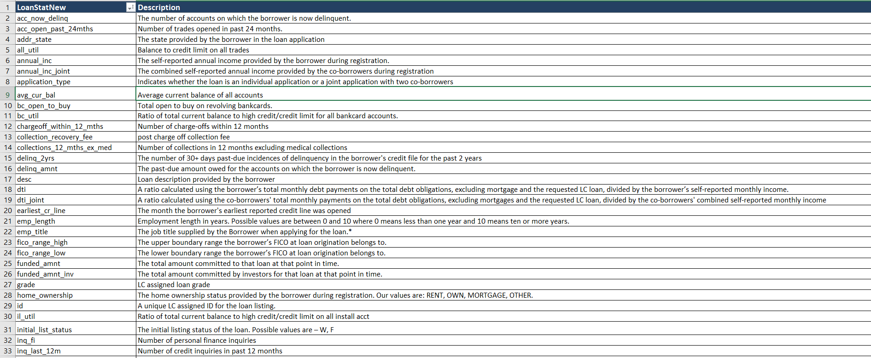
We are going to work with the loan data

Slide 4
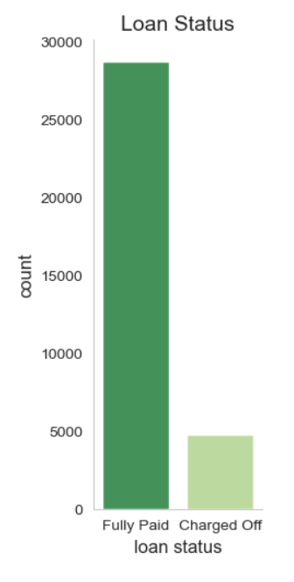
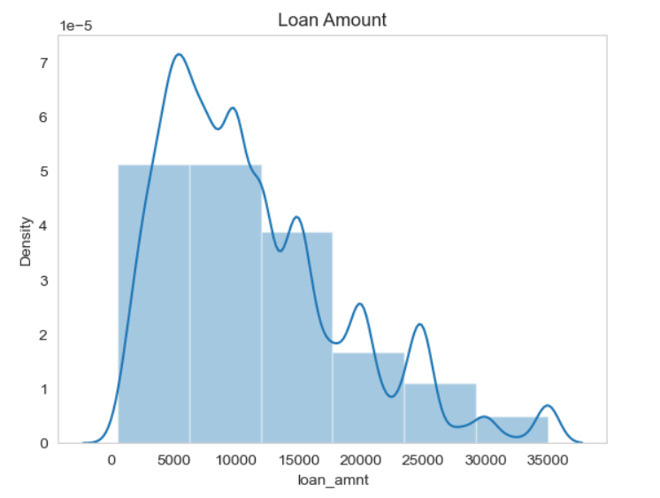
Analysis – Key Graph 1
Univariate Analysis
Distribution of loan amount
The graph shows that around 5000 people have defaulted/charged off.
The graph above shows that the loan amount is majorly spread around say 6000 to 18000 approximately

Slide 5
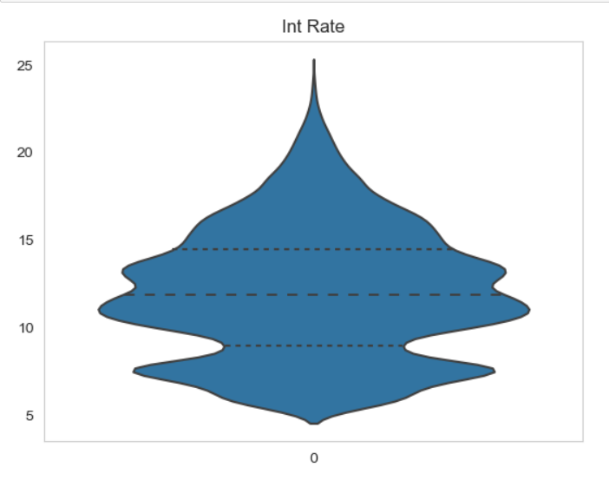
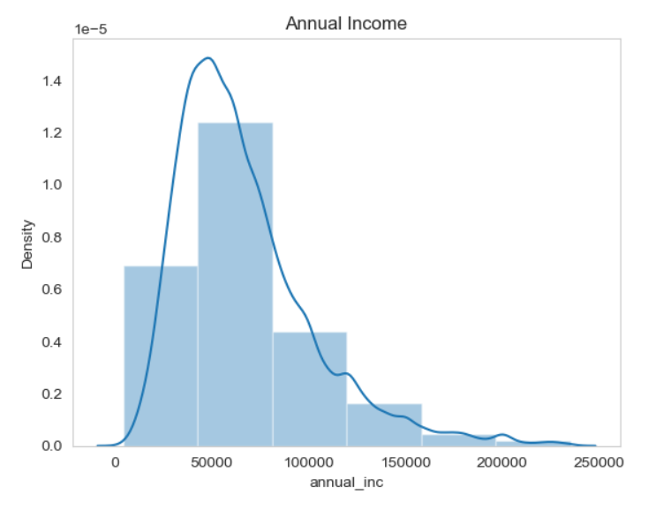
Analysis – Key Graph 2
The above graph shows that the interest rate is spread majorly between 8% and 14% approximately
As per the above graph, majority of the applicants have an annual income ranging approximately between 40000 USD to 90000 USD.

Slide 6
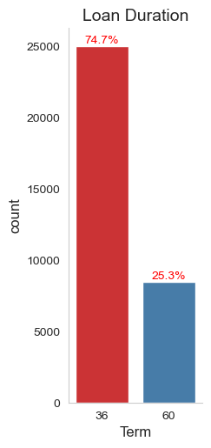
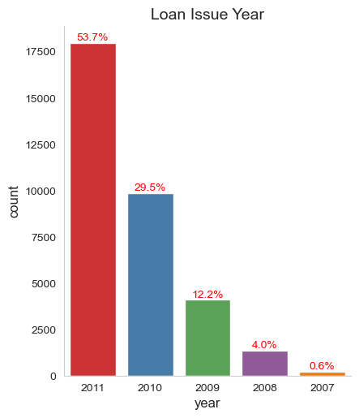
Analysis – Key Graph 3
As per the above graph, majority of the applicants have taken the loan duration as 36 months (74.7%)
Per the above graph, applicants for loan increased as the years increased. In 2011 the number of applicants for loan was 53.7%. Since the variable issue year does not provide us any direction in the analysis, we would not be using this variable for any further analysis.

Slide 7
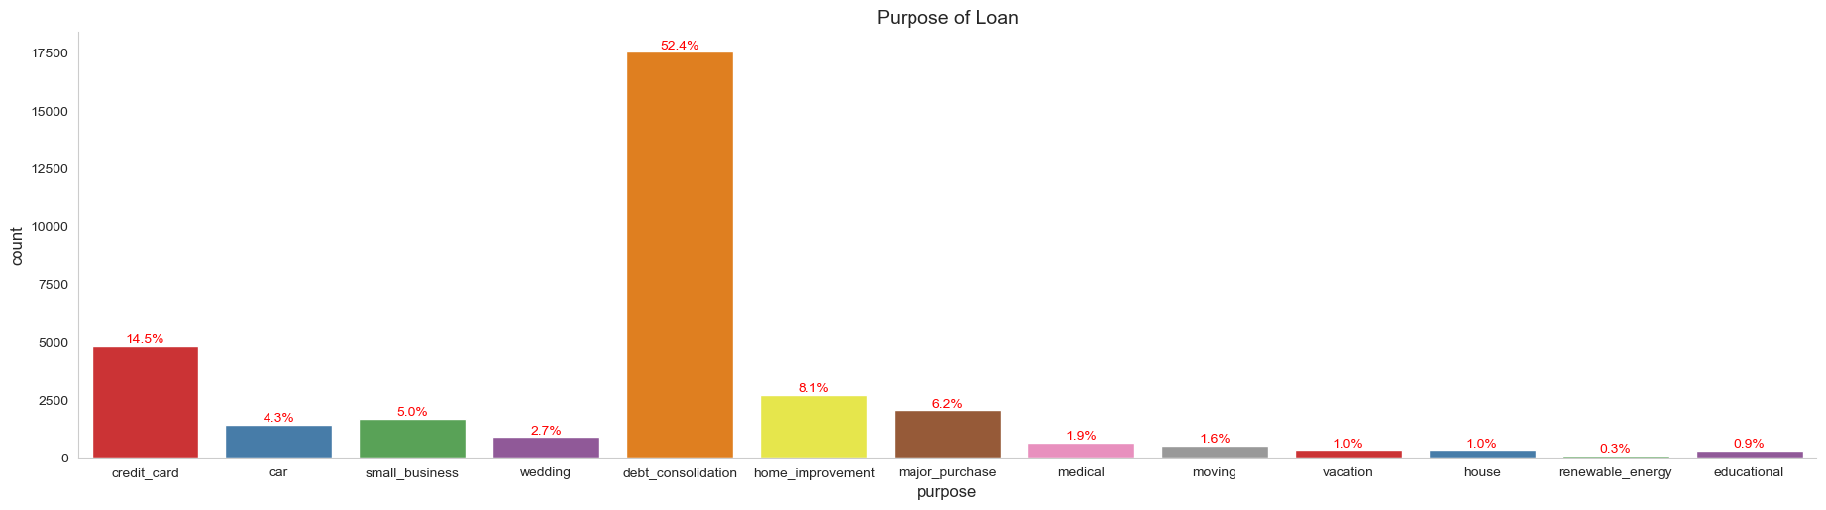
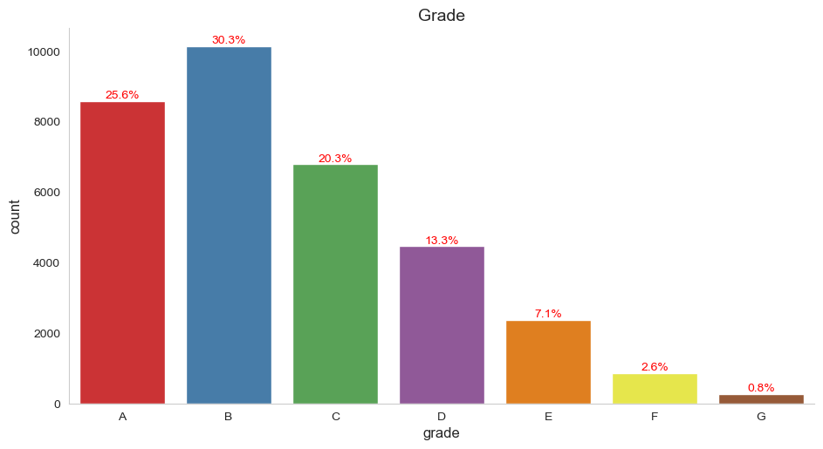
Analysis – Key Graph 4
The following are the purposes for which more than 5% applicants have taken loan
debt_consolidation - 52.4%
credit_card - 14.5%
home_improvement - 8.1%
major_purchase - 6.2%
small business - 5.0%
The above graph shows that most of the applicants fall under the grade B(30.3%), followed by A(25.6%) and C(20.3%)

Slide 8
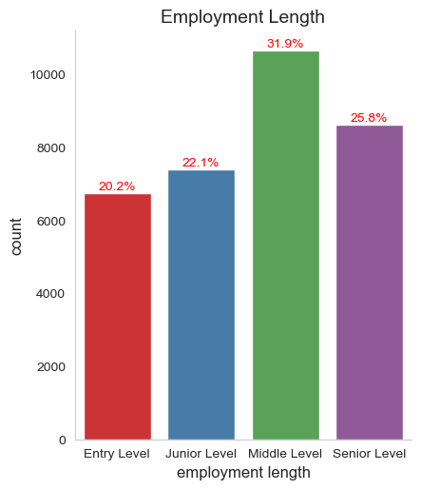
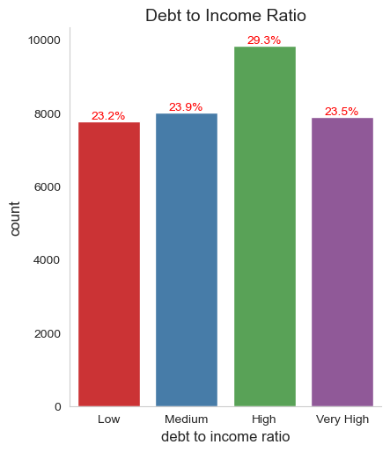
Analysis – Key Graph 5 Univariate Analysis
There are more number of loan applicants belonging to the middle level catgory (31.9%) i.e. between 4 to 8 years

Slide 9
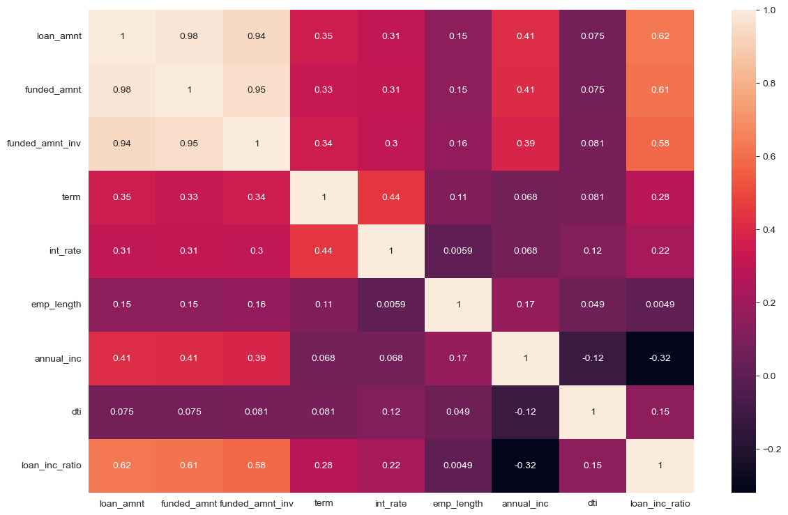
Analysis – Key Graph 6 Bivariate Analysis
The heat map shows that the loan_amount, funded_amount and funded_amount_inv are very closely correlated. Hence we can safely take any one of the fields from the above 3 fields for our analysis.

Slide 10
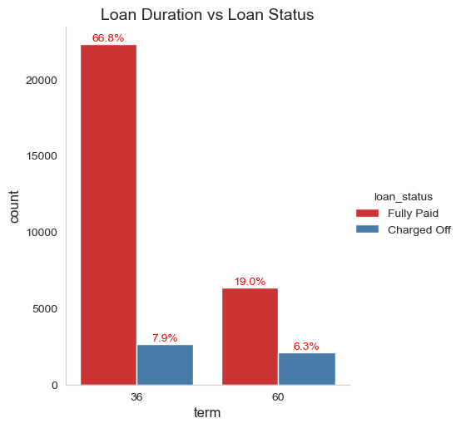
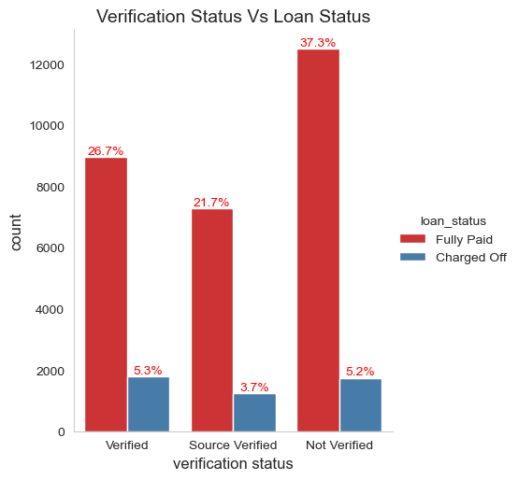
Analysis – Key Graph 7

Slide 11
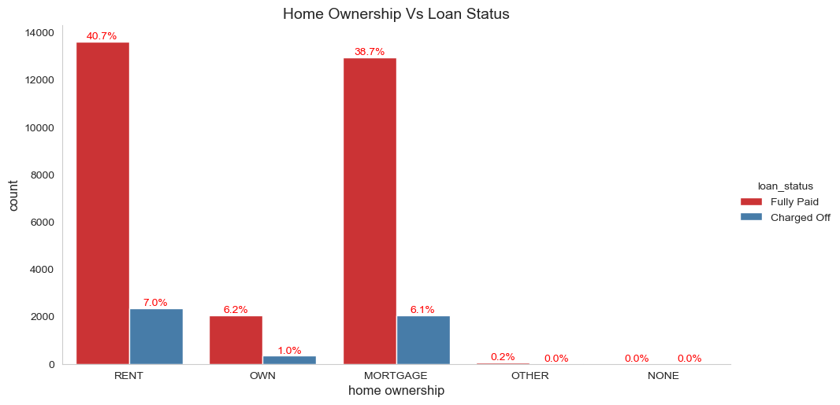
Analysis – Key Graph 8

Slide 12
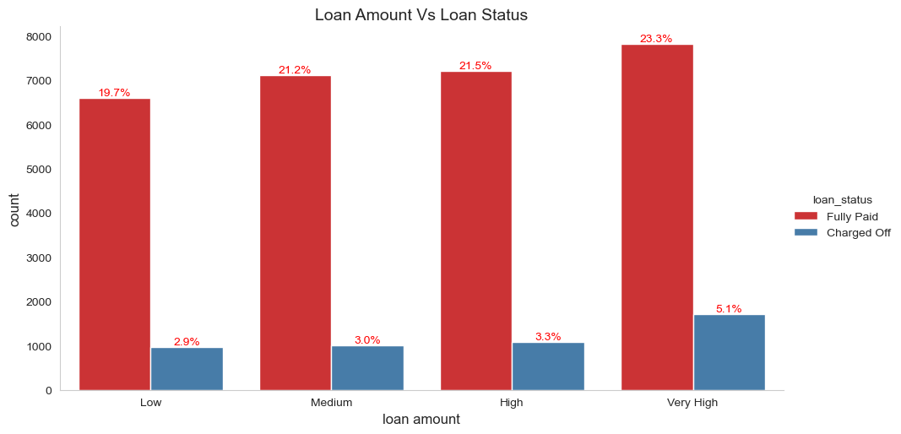
Analysis – Key Graph 9

Slide 13
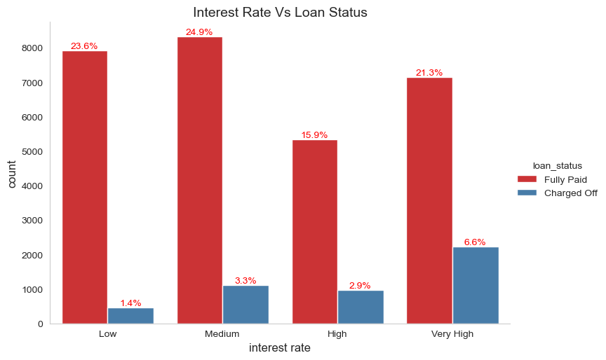
Analysis – Key Graph 10

Slide 14
Analysis – Key Graph 11

Slide 15
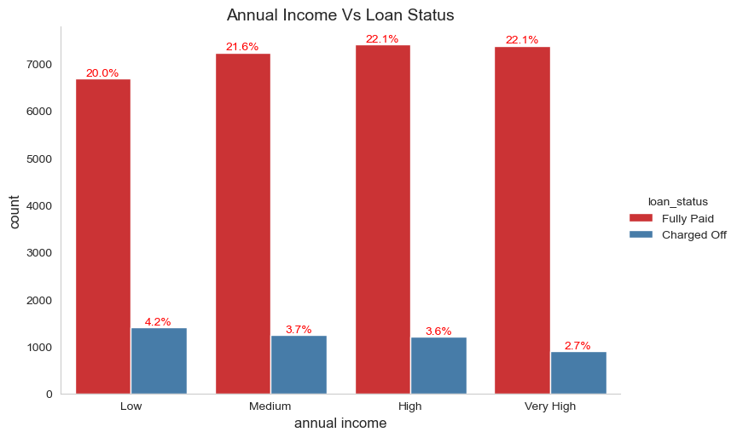
Analysis – Key Graph 12

Slide 16
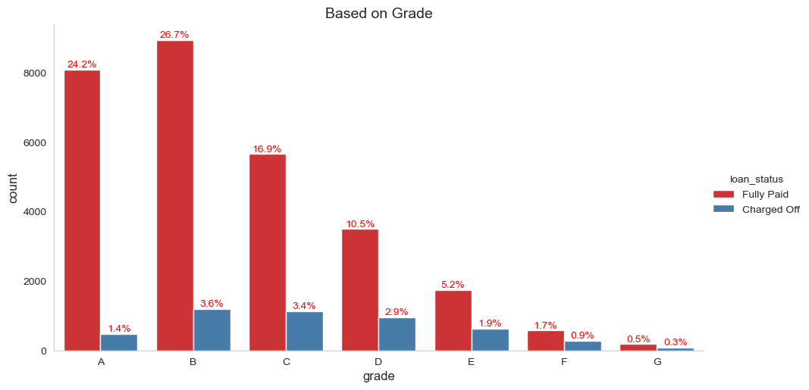
Analysis – Key Graph 13

Slide 17
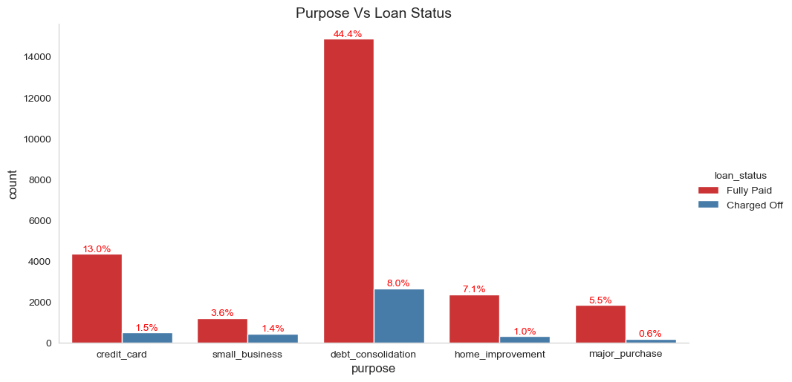
Analysis – Key Graph 14

Slide 18
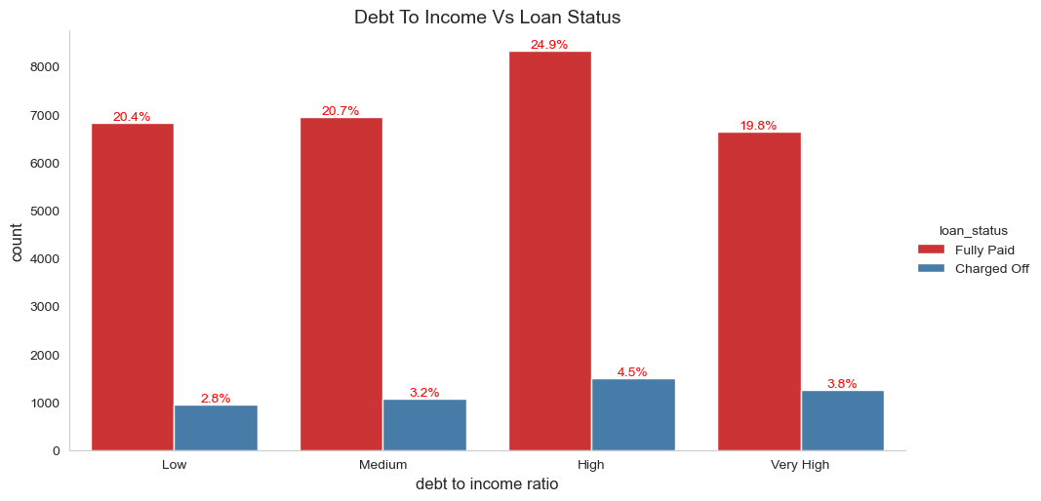
Analysis – Key Graph 15

Slide 19
THANK YOU
ABHINAV SHARMA

